Slide 1
Corporate Governance
and Firm Value : The Impact
of the 2002 Governance Rules
財務管理 第七組
311707037 黃培欣
311707001 邢子謙
311707018 劉熒嫈
311707033 梁嘉程

Slide 2
01
Agenda
Introduction
02
Methodology
03
Result
04
Robustness Test
05
Conclusion

Slide 3
Ⅰ. Introduction

Slide 4
What’s the point?
2002 Governance Rule
$↓$
Firm Value
$$Announcement$$
$$Effect$$
$$Firm sizes$$
We want to know :
Whether the rules have any significant effect on firm value?
Whether there is a difference in the announcement effect across small and large firms?

Slide 5
Prior research
1. Relation between corporate governance and firm value
Firm Value (Y)$↔Governance Structure (X)$
Endogenous relation
Rules are
Outside intervention
2. Announcement effect of the SOX on firm value
Zhang (2005)—negative effect of SOX on firm value
Li, Pincus, and Rego (2006) —positive effect of SOX on firm value Jain and Rezaee (2006)—positive effect of SOX on firm value
Large event window

Slide 6
Background
2001/11/8
2002/2/13
2002/10/9
Enron filed restated financial results with the SEC
SEC asks NYSE and NASDAQ to review their corporate governance requirement
NASDAQ submits its proposed rules (2nd round) to the SEC
2001/12/2
2002/7/25
Enron files for bankrupcy
House and Senate approve the SOX bill

Slide 7
Sarbanes–Oxley Act
Establishment of Public Corporation Accounting Oversight Board
Restrictions on public accounting firms
NYSE
Corporate responsibility
A majority of independent directors
An independent audit committee
An independent nominating committee
An independent compensation committee
Enhanced financial disclosure and internal controls
Increased penalties for corporate fraud

Slide 8
Portfolio
Test :
Whether less compliant portfolio outperforms or underperforms during the announcement period
Internal Control
Financial
Reporting
Board and
Committee
Independence
Insider Trading
Related
Party
Transaction

Slide 10
Ⅱ. Methodology

Slide 16
Ⅲ. Result

Slide 24
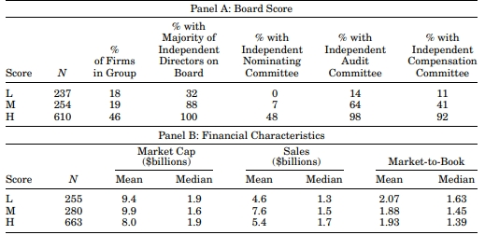
Table IV-Director Independence
Sample Range : Before 2000
Data source: IRRC & Compustat and CRSP databases
NYSE
1. A majority of independent directors
2. An independent audit committee
3. An independent nominating committee
4. An independent compensation committee
SOX
An independent audit committee
The majority of firms in our sample comply with all or most of the board independence requirements

Slide 25
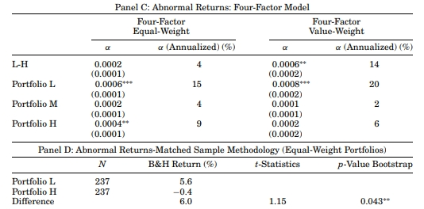
Table IV-Director Independence
Portfolio L'α coefficient
only the firms that are most affected by the
rules should realize abnormal returns
heterogeneity in responses across different firm sizes

Slide 26
Table V-Internal Controls
Sample Range : 2001/01~2001/09
Data source: the Auditor Track database of Strafford Publications Inc
suggesting that our sample does not outperform the matched sample
Value weight
考慮市值後大公司比重較大才會有顯著影響

Slide 27
Heterogeneity in Response across Firm Sizes
Several studies suggest that the rules are more likely to benefit large firms than small firms
Higher fixed costs of complying with the rules
Higher costs of finding qualified independent directors

Slide 28
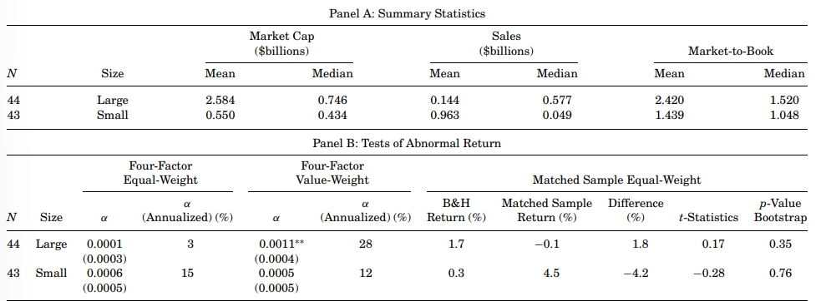
Table VI-Internal Control by Firm Size
Large firms: The α coefficient of the value-weight portfolio is statistically significant
Small firms: The α coefficients of both the equal-weight and the value weight portfolios are not significant

Slide 29
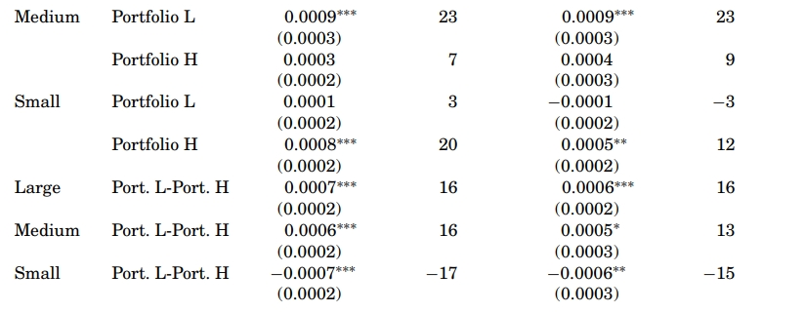
Table VII-Director Independence by Firm Size
In large and medium firms:
portfolio L has a significantly and positive α coefficient
In small firms:
portfolio L does not exhibit any significant return.
portfolio H exhibits significantly positive returns

Slide 30
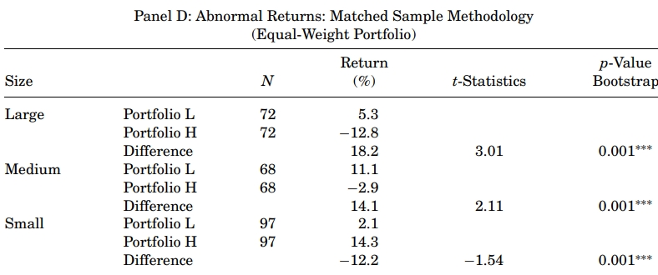
Table VII-Director Independence by Firm Size
Small firms呈現負差異報酬 因為要符合rules的成本高

Slide 31
Ⅳ. Robustness Test

Slide 32
A. Abnormal Return Outside the Event Window
2001/01
2001/11
2002/10
2002/11
2001/10
Event Window
2003/07
Find no abnormal returns in any portfolios in the pre and post event periods

Slide 33
B. Controlling for Other Financial and Governance Characteristics
Solution : 檢定sample portfolios&matching porfolios是否有差異
(by t-test and Wilcoxon test)
Results may be driven by some firm characteristics
EX:CEO holdings, leverage, book assets...
Question
institutional holdings, outside financing, leverage, book assets, and sales
都沒有明顯差異
Result Ⅰ
Result Ⅱ
board and CEO holdings 在獨立性方面有明顯差異

Slide 34
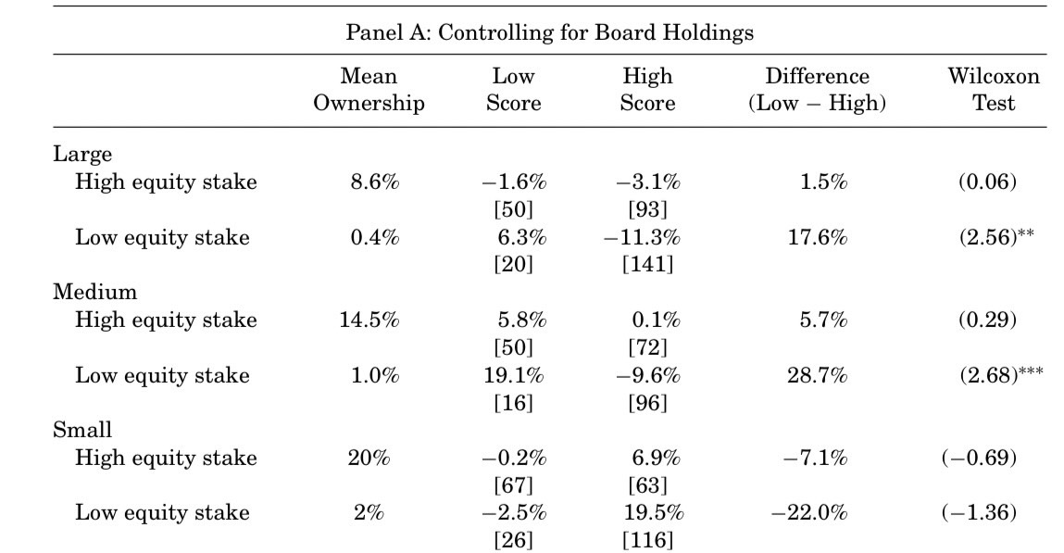
Table VIII- Abnormal Returns: Controlling for Other Governance Characteristics
時間(B&H Return) : 2001/11~2002/10
在高股權公司 : 董事獨立性的高低，對報酬無顯著差異。
在低股權公司 : 董事獨立性低的(L)公司，相對獨立性高的(H)獲得較高報酬，而且只有在大公司才顯著。
問題:那是甚麼造成TableⅦ小公司顯著的負異常回報?

Slide 35
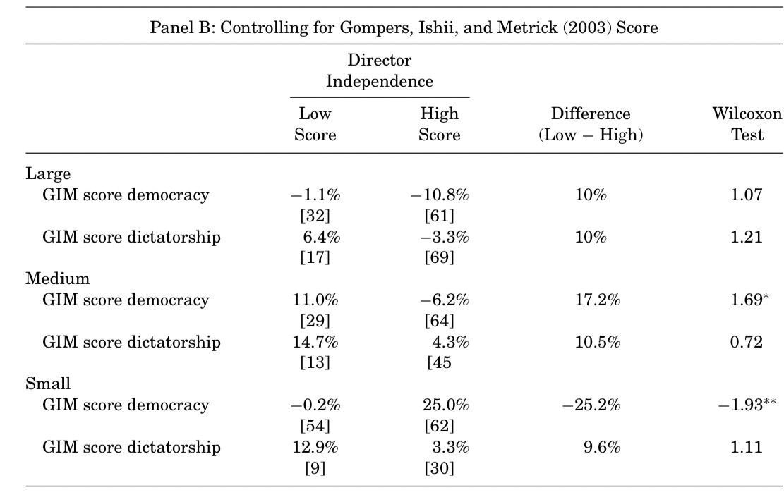
Table VIII- Abnormal Returns: Controlling for Other Governance Characteristics
GIM(Gompers, Ishii, and Metrick (2003)):反映對被收購的脆弱程度和股東影響決策能力，分成"民主"和"獨裁"兩類
中大公司 : 有異常正回報但不顯著。
小公司 : 顯著為負，民主和獨裁的差異甚大，原因可能是民主公司受到更多收購市場的約束性。
positive impact on large and medium firms.(持股數低時顯著)
negative impact in smaller firms.(民主公司時顯著)

Slide 36
C. Association of Abnormal Return with Rule Announcements
So far in the analysis we use a large window
Question
it might capture other events during the period that cause a similar effect on prices.
We use an event window of one day around rule-related announcements.
Note that the announcement events are not independent across firms(Schwert (1981)).
Benchmark

Slide 37
C. Association of Abnormal Return with Rule Announcements
1.Methodology: Schipper and Thompson (1983, 1985)
For each of these groups to estimate the following regression
Separate firms(小到大): J firms × T (237 days) (2001/11-2002/10)
Select all firms from the director independent portfolio with a score of zero.
2. Spirit : Separate event dates and increase control variables to reduce residuals

Slide 38
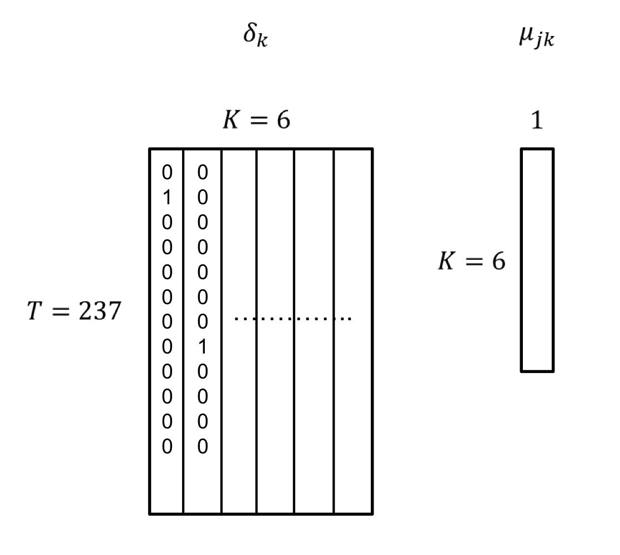
Methodology: Schipper and Thompson (1983, 1985)
δk : 事件參數的k×1向量乘以監管公告變數
µjk : 監管變化變數的T×K矩陣，每列考慮一項監管變化(此處k=6)
µjk δk
We identify from Figure 1 six important announcement dates that are related to the rulings.
H0: µjk = 0 , ∀ j
1 : 有監管
0 : 無監管

Slide 39
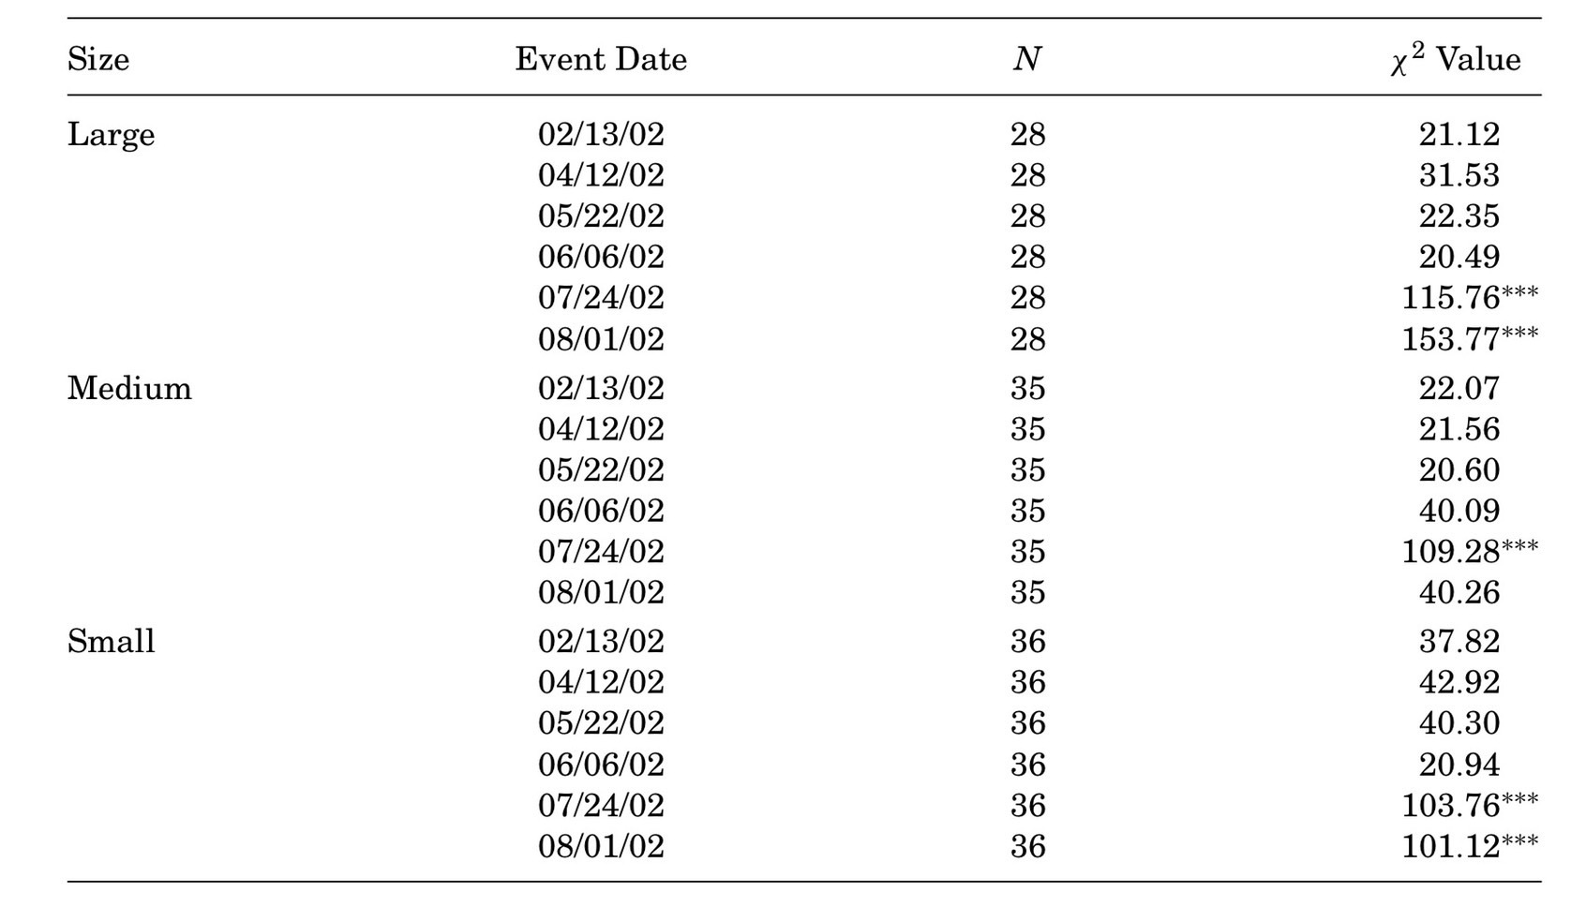
Table IX- Abnormal Returns on Specific Ruling Dates
卡方值:檢測公告效應中不考慮方向，只須確定效果
2002年7月24號，國會宣佈就SOX達成共識，以及NASDAQ董事會準予納斯達克的治理提案之日，所有規模的集團都有顯著的公告效應。
2002年8月1日，NYSE董事會準予紐約證券交易所提案之日，對大公司和小公司也產生了重大影響。

Slide 40
D. The Effect of the Worsening Corporate Scandals on Firm Value
Question
The worsening of the corporate scandals should have a larger negative effect on firms that are less compliant with the rules.
Solution
Choose the periods in which the corporate scandals worsened
(2001/10/10-2001/10/20)
(2001/10/10-2001/12/01)

Slide 41
D. The Effect of the Worsening Corporate Scandals on Firm Value
董事獨立性低的公司，相對獨立性高的獲得更低報酬。
大公司的結果與規則頒布後的結果相反!
相較於10/10~10/20的事件窗，另一個的惡化程度越大，尤其對於大公司為更顯著
It is true that it is worse, and the deterioration of corporate scandals has a greater negative impact on companies that do not play by the rules.
滿足作者假設

Slide 42
Ⅴ. Conclusion

Slide 43
Summary
A positive abnormal return in firms that are less compliant with the rules.
Rules associated with board independence and internal controls do not enhance the value of small firms.
 | Four-Factor Model Equal-weight | Four-Factor Model Value-weight | Matched Sample
Table IV Director Independence | L+ H+ | L+ HX | +
Table V Internal Control | X | + | X
Table VI Internal Control Firm size | Large:X Small:X | Large:+ Small:X | Large:X Small:X
Table VII Director Independence Firm Size | Large:L+ Medium:+ Small:- | Large:+ Medium:+ Small:+ | Large:+ Medium:+ Small:-

Slide 44
THANK YOU
財務管理報告—第七組

